Slide 1

Arrays

Slide 2
What is Array?
An array is a group of elements(data items) that have a common characteristics and share a common name.
It is simply a group of datatypes.
An array is used to represent a list of numbers , or a list of names.

Slide 3
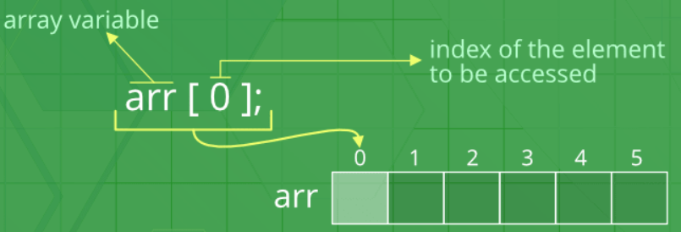
Example of Arrays:
For Example, to represent 100 students in college , can be written as
student [100]
Here student is a array name and [100] is called index or subscript.

Slide 4
Types of Arrays
One-dimensional arrays
Two-dimensional arrays
Multidimensional arrays

Slide 5
One-dimensional Arrays:
A variable which represent the list of items using only one index (subscript) is called one-dimensional array.
The general form of array declaration is type array-name[size];
Here the type specifies the data type of elements contained in the array, such as int, float, or char.
And the size indicates the maximum numbers of elements that can be stored inside the array.
The size should be either a numeric constant or a symbolic constant.

Slide 6
For Example , If we want to represent a set of five numbers say (35,40,20,57,19), by an array variable number, then number is declared as follows
int number [5] ;
and the computer store these numbers as shown below : number [0]
number [1]
number [2]
number [3]
number [4]
The values can be assigned to the array as follows : number [0] = 35;
number [1] = 40;
number [2] = 20;
number [3] = 57;
number [4] = 19;

Slide 7
INITIALIZATION OF ONE-DIMENSIONAL ARRAYS :
An array can be stored in following stages :
At compile time
At run time
Compile time initialization :
In compile time initialization, the array is initialized when they are declared.
The general form of initialization of array is :
type array-name[size] = { list of values };
The list of values are separated by commas.

Slide 8
Example :
int number[ ] = {1,2,3,4};
The character array can be initialized as follows :
char name[ ] = {‘j’,’o’,’h’,’n’,’\0’};
The character array can also be initialized as follows : char name[ ] = “john”;

Slide 9
Run time initialization :
In run time initialization, the array is explicitly initialize at run time.
This concept generally used for initializing large arrays. Example:
for(i=0; i < 100; i++)
{
if( i < 50) sum[i] = 0.0; else
sum[i] = 1.0;
}
Here first 50 elements of the array sum are initialized to 0 and the remaining 50 elements are initialized to 1 at runtime.

Slide 10
//Example for single dimensional array
#include<stdio.h>
#include<conio.h>
int main()
{
int a[5],i;
printf("Enter the 5 values");
for(i=0;i<5;i++)
{
scanf("%d",&a[i]);
}
printf("The five values are");
for(i=0;i<5;i++)
{
printf("a[%d] is %d\n",i,a[i]);
}
getch();
}
Output:
Enter the 5 values
12
25
37
42
58
The five values are
a[0] is 12
a[1] is 25
a[2] is 37
a[3] is 42
a[4] is 58

Slide 11
Two-dimensional Arrays
■
A variable which represent the list of items using two index (subscript) is called two-dimensional array.
■
In Two dimensional arrays, the data is stored in rows and columns format.
■
For example:
int table[2][3];

Slide 12
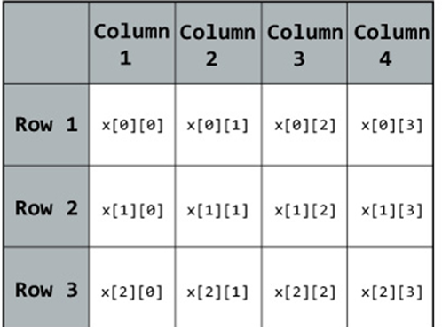
DECLARATION OF TWO-DIMENSIONAL ARRAYS :
The general form of two dimensional array declaration is :
type array-name[row_size][column_size];
Here the type specifies the data type of elements contained in the array, such as int, float, or char.

Slide 13
INITIALIZATION OF TWO-DIMENSIONAL ARRAYS :
The general form of initializing two-dimensional array is :
type array-name[row_size][column_size] = {listof values};
Example :
int table[2][3] = {0,0,0,1,1,1};
Here the elements of first row initializes to zero and the elements of second row initializes to one.
This above statement can be written as :
int table[2][3] = {{0,0,0}, {1,1,1}};

Slide 14
We can also omit the assigning of row value.
Example :
int table[ ][3] = {{0,0,0}, {1,1,1}};
If the values are missing in an initializer, they are automatically set to zero.
Example :
int table[2][3] = {1,1,2};
Here first row initialize to 1,1 and 2, and second row initialize to 0,0 and 0 automatically.

Slide 15
Memory Layout of Two-dimensional array :
In Two dimensional arrays, the data is stored in rows and columns format.
For example:
int table[2][3] = {1,2,3,4,5,6};
The memory layout of above example : table[0][0] = 1;
table[0][1] = 2
table[0][2] = 3;
table[1][0] = 4;
table[1][1] = 5;
table[1][2] = 6;

Slide 16
//Example
#include<stdio.h>
#include<string.h>
#include<conio.h>
int main()
{
int a[10][10],b[10][10],d[10][10],r,c,i,j;
{
printf("enter the rows and columns value\n");
scanf("%d%d",&r,&c);
printf("enter the first matrix value\n");
for(i=0;i<r;i++)
{
for(j=0;j<c;j++)
{
scanf("%d",&a[i][j]);
}
}

Slide 17
printf("enter the second matrix value\n");
for(i=0;i<r;i++)
{
for(j=0;j<c;j++)
{
scanf("%d",&b[i][j]);
}
}
printf("the addition matrix is\n");
for(i=0;i<r;i++)
{
for(j=0;j<r;j++)
{
d[i][j]=a[i][j]+b[i][j];
printf("%d\t",d[i][j]);
}
printf("\n");
}
}
getch();
return 0;
}
Output:
enter the rows and columns value
2
2
enter the first matrix value
5
5
5
5
enter the second matrix value
4
4
4
4
the addition matrix is
9 9
9 9

Slide 18
multi-dimensional Arrays
A variable which represent the list of items using more than two index (subscript) is called multi-dimensional array.
The general form of multi dimensional array is :
type array-name[s1][s2][s3]…….[sn];
Where S is the size.
Some examples are :
int survey[3][5][6];
float table[5][4][5][3];
Here survey is a three-dimensional array And table is a four-dimensional array.

Slide 19
exercise:
Write a C program of ‘initialization and printing the value’ using array.
Write a C program to display ‘Kanyakumari’ using array.
Write a C program of multiplication of two matrix.
Write a C program to display any particular month of twelve months using character array.

Slide 20
THANK YOU
PRESENTED BY,
SARANYA M

